Slide 1
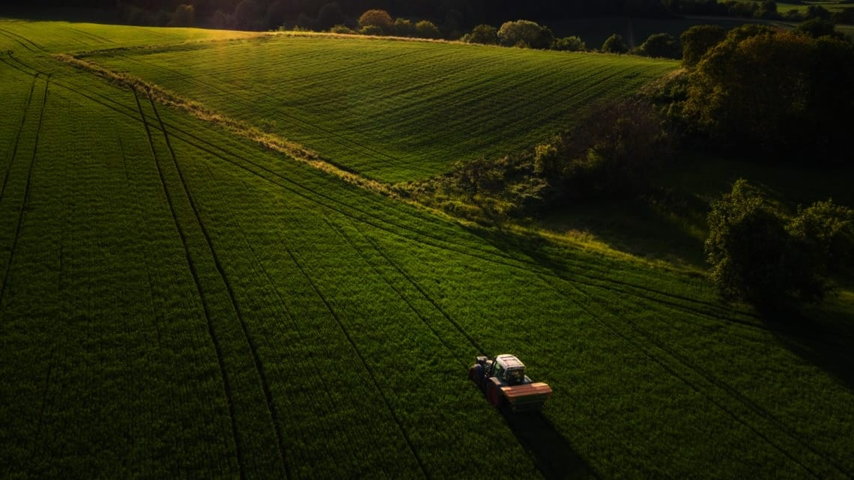
KNOW YOUR CROP
Presented By: RAKESH NARAYANAN CN
Roll No: SCM22MCA-2021
Guided By: Ms. DEMY DEVASSY
IoT BASED CROP PREDICTION SYSTEM

Slide 2




KYC
Know Your Crop

Slide 3
INTRODUCTION
EXISTING SYSTEM
PROPOSED SYSTEM
LITREATURE REVIEW
DATASET
ALGORITHM
HARDWARE COMPONENTS
SOFTWARE SPECIFICATIONS
WORKING
RESULT AND ANALYSIS
CONTENTS

Slide 4
INTRODUCTION
Better soil, Better Future. As a farmer it is necessary to know the nature of soil and which crop is best suitable for the soil. “ KNOW YOUR CROP ” , a soil monitoring system enabled by the IoT allows farmers to predict which crops will grow based on soil factors.

Slide 5
Our goal is to create a crop predicting tool by temperature, moisture, humidity, and pH-value are monitored using IOT sensors.
Data from IoT sensors can then particular soil type. be transferred to a central location for pattern detection, processing and visualization.
This will help the new farmers to seed the proper crops.

Slide 6
EXISTING SYSTEM
The existing system for crop prediction using soil analysis typically involves manual methods, limited data sources, and less sophisticated technology. Farmers collect soil samples from their fields and send them to local agricultural laboratories for testing. This process is time-consuming and can delay decision-making.

Slide 7
PROPOSED SYSTEM
Proposed system for crop prediction using soil analysis implement IoT sensors in the fields to continuously monitor soil parameters like moisture levels, temperature, humidity and pH-Value. This real-time data can be transmitted to a centralized system. The system aims to help farmers for smart decision while predicting the crops.

Slide 8
LITREATURE REVIEW
TITLE | AUTHORS | METHODS
Smart Crop Prediction using IoT and Machine Learning | Archana Gupta, Dharmil Nagda, Pratiksha Nikhare, Atharva Sandbhor | It involves monitoring soil properties to recommend suitable crops. Machine learning techniques like Decision Tree, K-nearest neighbors, and Support Vector Machine are applied to analyze data and provide accurate crop predictions. Accuracy: Above 90 %

Slide 9
TITLE | AUTHORS | METHODS
Crop Prediction Using Machine Learning | Madhuri Shripathi Rao, Arushi Singh, N.V. Subba Reddy, and Dinesh U Acharya | Compares popular algorithms such as K-Nearest Neighbor (KNN), Decision Tree, and Random Forest Classifier using two different criteria – Gain and Entropy. Accuracy : 99.32% for Random Forest, 97.4 for KNN, 98.6 for Decision Tree
Real-time soil fertility analyzer and crop prediction system | Dharesh Vadalia, Minal Vaity, Krutika Tawate, and Dynaneshwar Kapse. | Involves using sensors to calculate the soil nutrient contents (nitrogen, phosphorus, and potassium) by measuring the pH of the soil and electrical conductivity. The system averages the results of multiple soil tests to determine the approximate fertility of the total land.

Slide 10
TITLE | AUTHORS | METHODS
Proficient Smart Soil-based IoT System for Crop Prediction | G Sai Pravallika, L Kundana, K Sri Thanvi, G Sirisha, & Ch. Rupa | Collects soil parameters and environmental conditions regularly. Uses the Support Vector Regression algorithm for analyzing the dataset. It predicts the suitable crop. Accuracy : 91.2 %
Crop prediction system using machine learning algorithms | Pavan Patil & Virendra Panpatil | Utilizes classification algorithms to predict expected knowledge. Decision tree classifier is employed’ Multiple linear regression is used as a generalized prediction model. Various supervised classification machine learning algorithms are implemented in the study. Accuracy: 76.8 For Decision Tree 89.4 for KNN

Slide 11
TITLE | AUTHORS | METHODS
IOT Based Smart Agricultural Management System | G. S. Nagaraja, Avinash B Soppimath, T. Soumya, Abhinith A | Sensor data is monitored using Raspberry Pi 3 and NodeMCU Devkit module with DHT-11 and Hygrometer sensors. SVM classifier algorithm is used with a dataset of over 700 records to predict suitable crops based on sensor data and user input.
Crop prediction system using machine learning approaches | Prof. D.S. Zingade, Omkar Buchade, Nilesh Mehta, Shubham Ghodekar, Chandan Mehta | Machine Learning, Crop Prediction, SVM, Rainfall, Agriculture, Soil Content, Fertilizer, Profit Margin, Soil Pollution, GPS Data.
Crop yield prediction using Deep Neural Network | Saeed Khaki | Deep Neural Network (DNN) Approach, Feature Selection, Comparison with Other Models. Accuracy : 88.3%

Slide 12
DATASET
DATASET DESCRIPTION
Dataset Available in Kaggle : https://www.kaggle.com/datasets/rishabhrathore055/datas/code
Consist Of 1400 data with 13 different Crops
Total 5 Columns : Temperature, Humidity, water availability, phValue
and label.

Slide 13
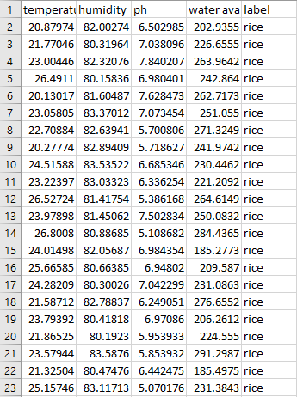
DATASET FILE

Slide 14
ALGORITHM
Crop prediction using soil analysis involves the application of various algorithms.
SVM - 96.6%
KNN - 97.4%
Decision Tree - 98.6%
Random Forest - 99.32%
Decision trees with 98.6% accuracy are used to create models that can predict the best crop based on soil characteristics. This project uses Random Forest Model, which is a combination of many decision trees for predicting accurate crops suited for soil factors.

Slide 15
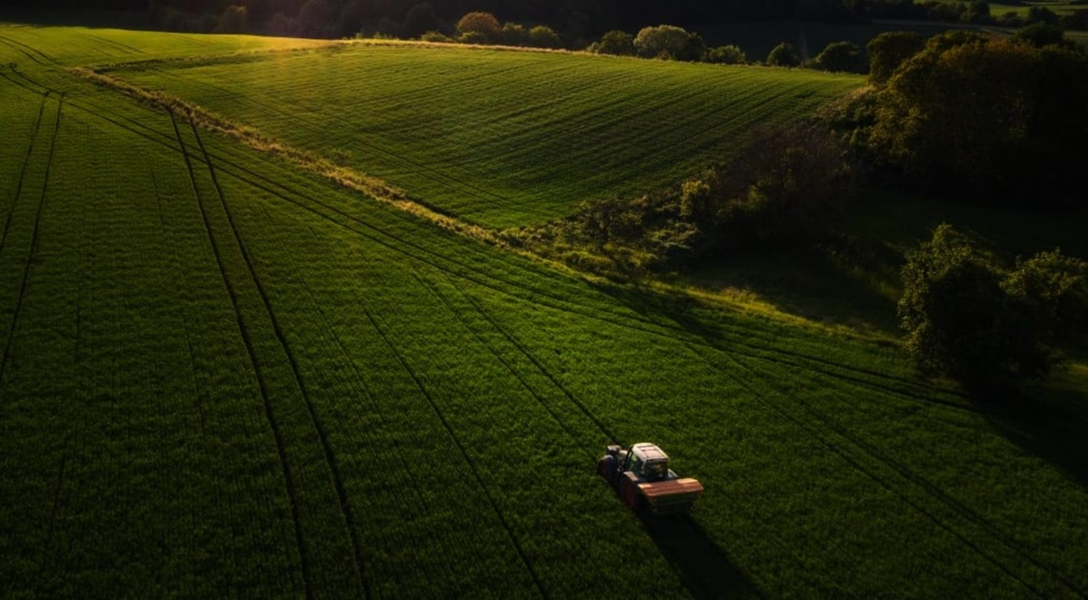
NODEMCU - ESP8266
Arduino UNO
Dht11 Temperature and Humidity Sensor
Soil Moisture Sensor
pH Sensor
ESP8266 WIFI Module
Bread Board
Jumper Wires
HARDWARE
COMPONENTS

Slide 16
PyCharm IDE
Arduino IDE
Python-Django
C++ Programming for Arduino
Thingspeak Server
SOFTWARE
SPECIFICATIONS

Slide 17
WORKING
The sensors like DHT11, Soil moisture sensor , pH Sensor are used to collect the data inputs like Temperature, Humidity, Moisture, and pH value with the help of ESP8266 NodeMCU and arduino UNO microcontrollers.
These values are then send to a cloud server, Thingspeak from where these data is fetched by the webpage.
The data that is fetched is produced to the trained Random forest model with accuracy 99.32% for predicting the crop that is suitable for the given conditions.

Slide 18
BLOCK DIAGRAM
Temperature & Humidity Sensor
NODE MCU
ESP8266
Soil Moisture Sensor
Cloud Server
Predict Crop
Soil pH Sensor
ARDUINO
UNO

Slide 19
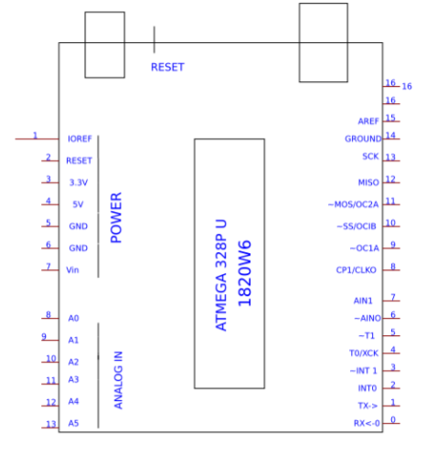
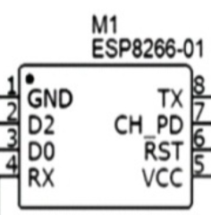
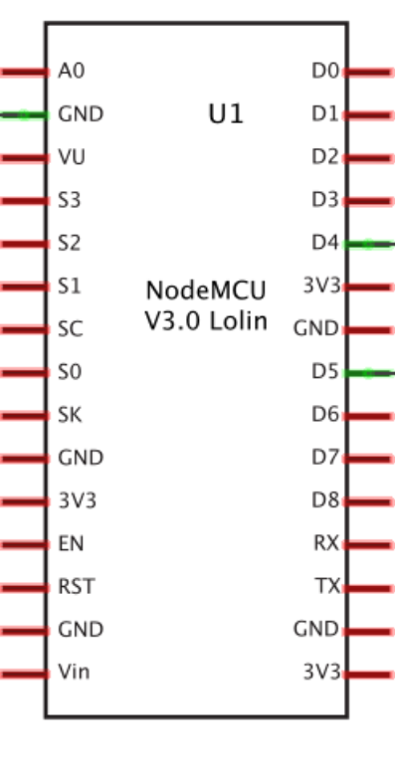
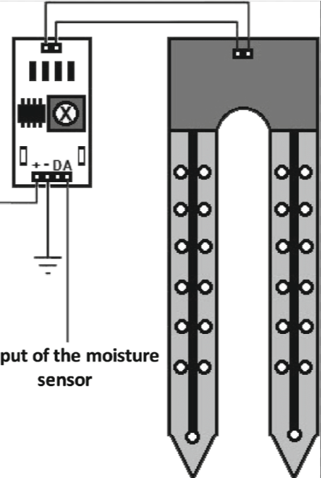
HARDWARE ARCHITECTURE
Soil Ph Sensor
ESP8266 WIFI Module
NodeMCU
ESP8266
VCC
DATA
GND
Soil Moisture Sensor
DHT11 Temperature and Humidity Sensor

Slide 20
RESULT AND ANALYSIS
Accurate predictions of which crops are most suitable for a given area or field based on given characteristics.
Continuous monitoring of soil conditions and adjustments to crop recommendations based on real-time data.

Slide 21
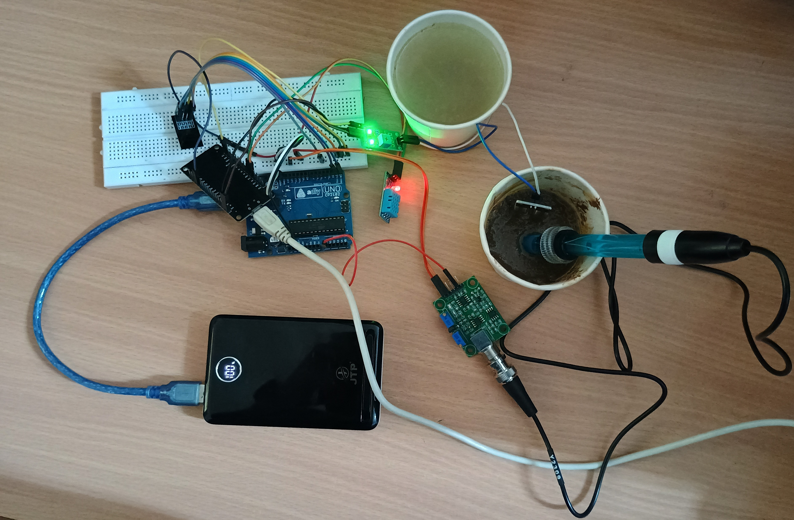

Slide 22
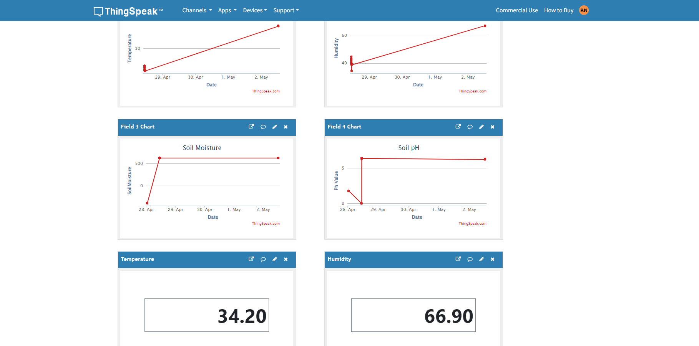

Slide 23
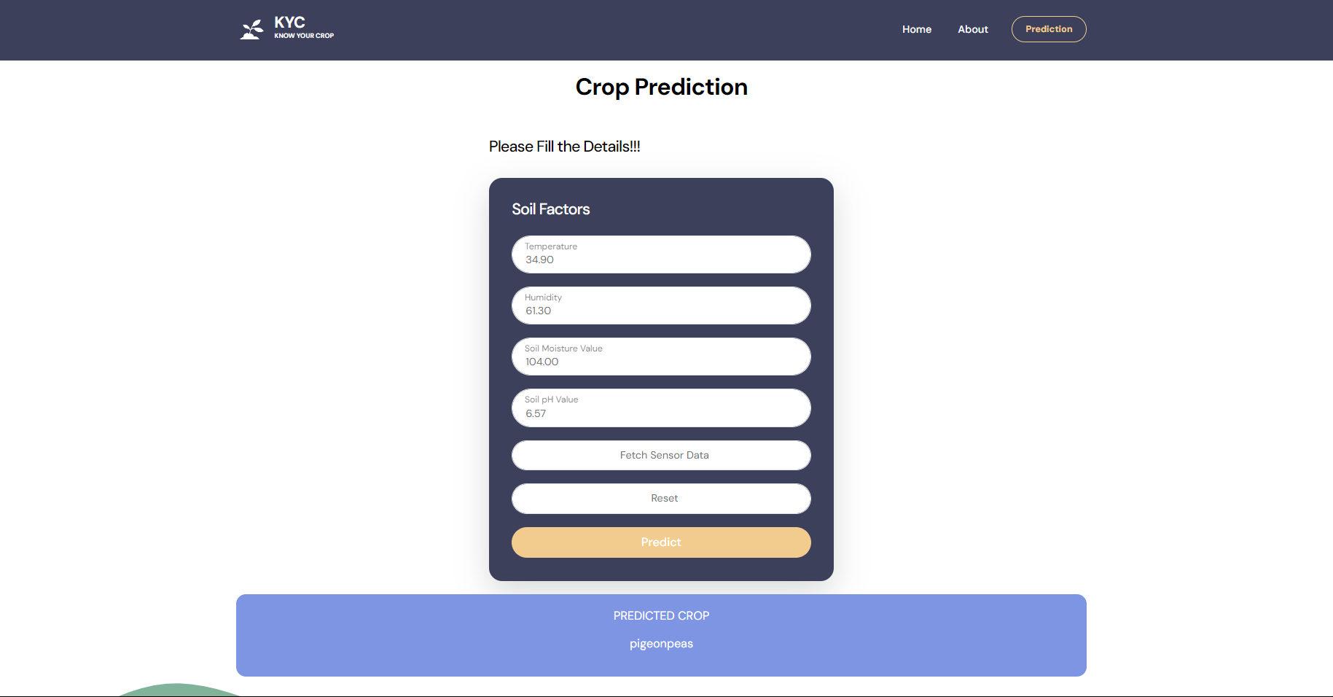

Slide 24

THANK YOU

